Slide 1
take-off
Rotation of lower leg around knee
landing
Convention followed:
Flexion negative
extension positive
jump
+
+
+
-
-
-
+
+
+
-
+
-
+
-
+
+
-
-
+
-
Ext
-
Ext
Ignore In air
ω
Ext
Ext
θ
Flex
Flex
t
Flex
Flex
α
Ext
Ext
Ext
Ext
Flex
Flex
ω
t
Flex
Flex
ω = 0
α= 0
ω = 0
ωpeak
ω = 0
α= 0
ω = 0
α= 0
ωpeak
α
α= 0
t
ωpeak
ωpeak

Slide 2
take-off
Rotation of lower leg around knee
landing
Convention followed:
Flexion negative
extension positive
jump
+
+
+
-
-
-
+
+
+
-
+
-
+
-
+
+
-
-
+
-
Ext
-
Ext
Ignore In air
ω
Ext
Ext
θ
Flex
Flex
t
Flex
Flex
α
Ext
Ext
Ext
Ext
ω = 0
ω = 0
Flex
Flex
ω
t
Flex
Flex
α= 0
ωpeak
ω = 0
α= 0
ω = 0
α= 0
ωpeak
α
α= 0
t
ωpeak
ωpeak

Slide 3
take-off
Rotation of lower leg around knee
landing
Convention followed:
Flexion negative
extension positive
jump
+
+
+
-
-
-
+
+
+
-
+
-
+
-
+
+
-
-
+
-
Ext
-
Ext
Ignore In air
ω
Ext
Ext
θ
Flex
Flex
t
Flex
Flex
α
Ext
Ext
Ext
Ext
ω = 0
ω = 0
Flex
Flex
ω
t
Flex
Flex
α= 0
ωpeak
ω = 0
α= 0
ω = 0
α= 0
ωpeak
α
α= 0
t
ωpeak
ωpeak

Slide 4
take-off
Rotation of lower leg around knee
landing
Convention followed:
Flexion negative
extension positive
jump
+
+
+
-
-
-
+
+
+
-
+
-
+
-
+
+
-
-
+
-
Ext
-
Ext
Ignore In air
ω
Ext
Ext
θ
Flex
Flex
t
Flex
Flex
α
Ext
Ext
ωpeak
ωpeak
Ext
Ext
ω = 0
Flex
Flex
ω
ωpeak
ωpeak
t
Flex
Flex
ω = 0
ω = 0
α= 0
α= 0
α= 0
α= 0
α
t

Slide 5
take-off
Rotation of lower leg around knee
landing
Convention followed:
Flexion negative
extension positive
jump
+
+
+
-
-
-
+
+
+
-
+
-
+
-
+
+
-
-
+
-
Ext
-
Ext
Ignore In air
ω
Ext
Ext
θ
Flex
Flex
t
Flex
Flex
α
Ext
Ext
ωpeak
ωpeak
Ext
Ext
ω = 0
Flex
Flex
ω
ωpeak
ωpeak
t
Flex
Flex
ω = 0
ω = 0
α= 0
α= 0
α= 0
α= 0
α
t

Slide 6
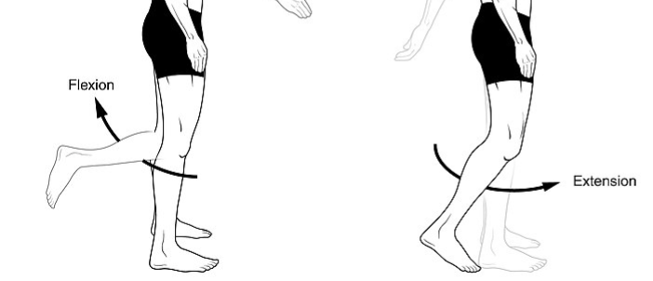
Indicate what direction torque the floor force, n, exerts on lower leg around knee
Flexion
Extension
https://commons.wikimedia.org/wiki/File:Body_Movements_I.jpg

Slide 7
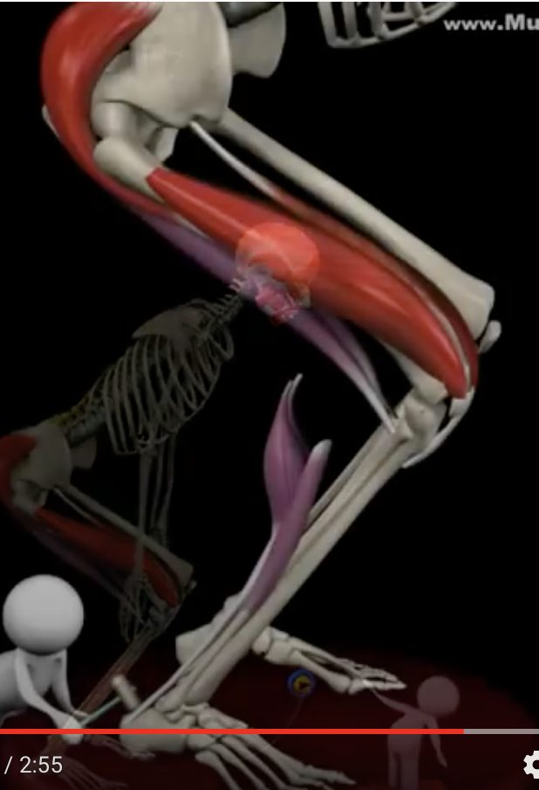
Limb: lower leg-foot
Joint axis: knee
4 pts.
The quadriceps can only cause torque of the lower leg around the knee in one rotation direction. Indicate which one.
Flexion
Extension
Hamstrings
The hamstrings can only cause torque of the lower leg around the knee in one rotation direction. Indicate which one.
Flexion
Extension
Quadriceps

Slide 8
Limb: lower leg-foot
Joint axis: knee
4 pts.
Quadriceps muscle torque can:
Speed up flexion
Slow down flexion
Speed up extension
Slow down extension
Bold all that apply
Drag
Eccentric
Concentric
Hamstrings
Eccentric
Concentric
Quadriceps
Hamstring muscle torque can:
Speed up flexion
Slow down flexion
Speed up extension
Slow down extension
Bold all that apply

Slide 9
Indicate if the floor force, n, can exert a torque in each case to cause the angular acceleration indicated?
If not, indicate which muscle needs to work – quadriceps or hamstring
Take-off
Positions will vary
Landing
Turnaround
Turnaround
n
ω
ω
𝜶
𝜶
n
quad
ham
n
quad
ham
n
quad
ham
n
quad
ham
n
quad
ham
n
quad
ham
n
quad
ham
n
quad
ham

Slide 10
Alternative: which force has the same rotation torque direction as the angular acceleration?
Indicate signs
± 𝝉_{M} ± 𝝉_{n} = ± I 𝜶
± 𝝉_{M} ± 𝝉_{n} = ± I 𝜶
Which force torque has to work?
Which force torque has to work?
n
quad
ham
n
quad
ham
ω
-
ω
+
𝜶
𝜶
ω
-
𝜶
-
± 𝝉_{M} ± 𝝉_{n} = ± I 𝜶
± 𝝉_{M} ± 𝝉_{n} = ± I 𝜶
Which force torque has to work?
Which force torque has to work?
n
quad
ham
n
quad
ham
ω
+
ω
+
+
𝜶
-
𝜶

Slide 11
take-off
Rotation of lower leg around knee
landing
Drag and resize to indicate where quads dominate
jump
Ignore In air
θ
t
ω
t
α
Drag and resize to indicate where hamstringsdominate
t

Slide 12
take-off
Rotation of lower leg around knee
landing
Drag and resize to indicate where quads dominate
jump
Ignore In air
θ
t
ωpeak
ωpeak
ω = 0
ω
ωpeak
ωpeak
t
α= 0
α= 0
α= 0
α= 0
α
Drag and resize to indicate where hamstringsdominate
t

